Slide 1

I To make Smart Home
HOME AUTOMATION WITH ARDUINO, PICSIMLAB,AND BLYNK IOT
Exploring the significance and implementation of smart home automation using Arduino, PICSimlab,and Blynk IOT for a more comfortable and efficient living experience.
Bhanavath Rakesh
Presenter

Slide 2
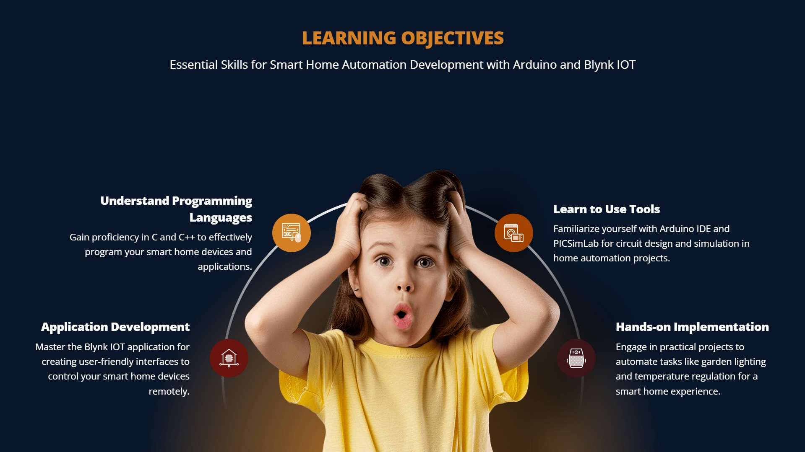

Slide 3
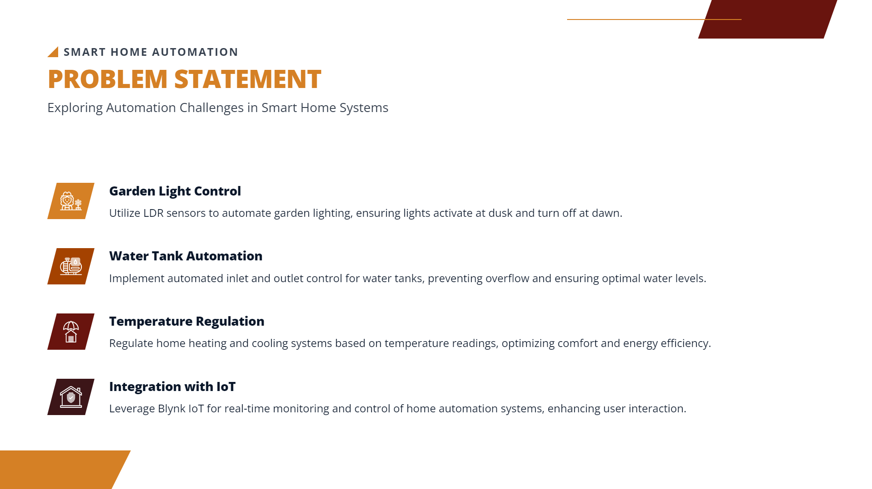


..iilllllll SMART HO ME AUTOMATION
PROBLEM STATEM ENT
Exploring Automation Challenges in Smart Home Systems
Ml
..
jt
II
Garden Light Control
Utilize LDR sensors to automate garden lighting, ensuring lights activate at dusk and turn off at dawn.
Water Tank Automation
Implement automated inlet and outlet control for water tanks, preventing overflow and ensuring optimal water levels.
Temperature Regulation
Regulate home heating and cooling systems based on temperature readings,optimizing comfort and energy efficiency.
Integration with loT
Leverage Blynk loT for real-time monitoring and controlof home automation systems, enhanc ing user interaction.

Slide 4
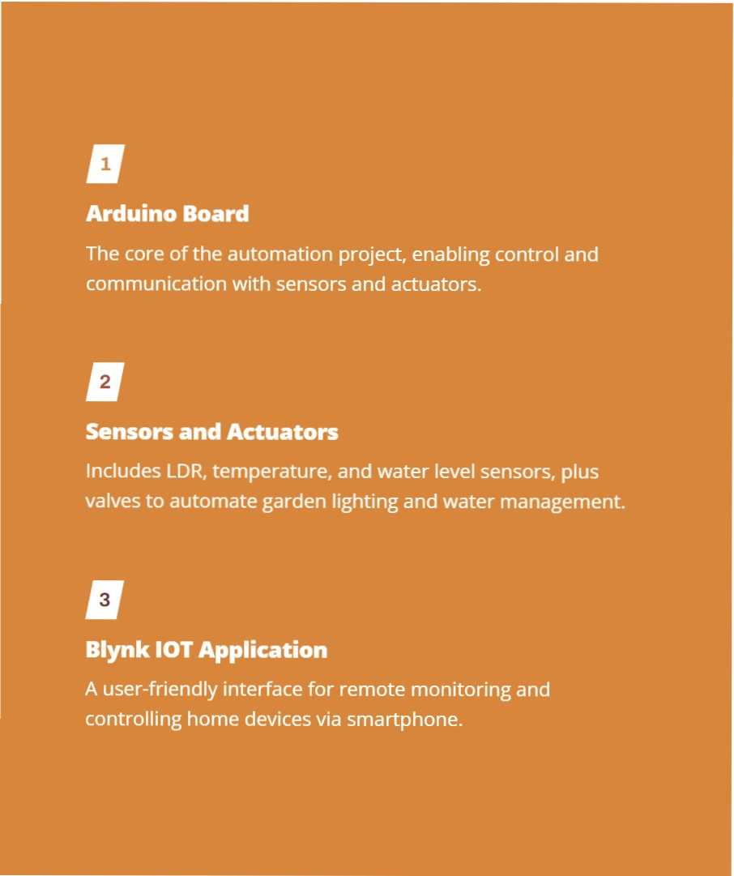
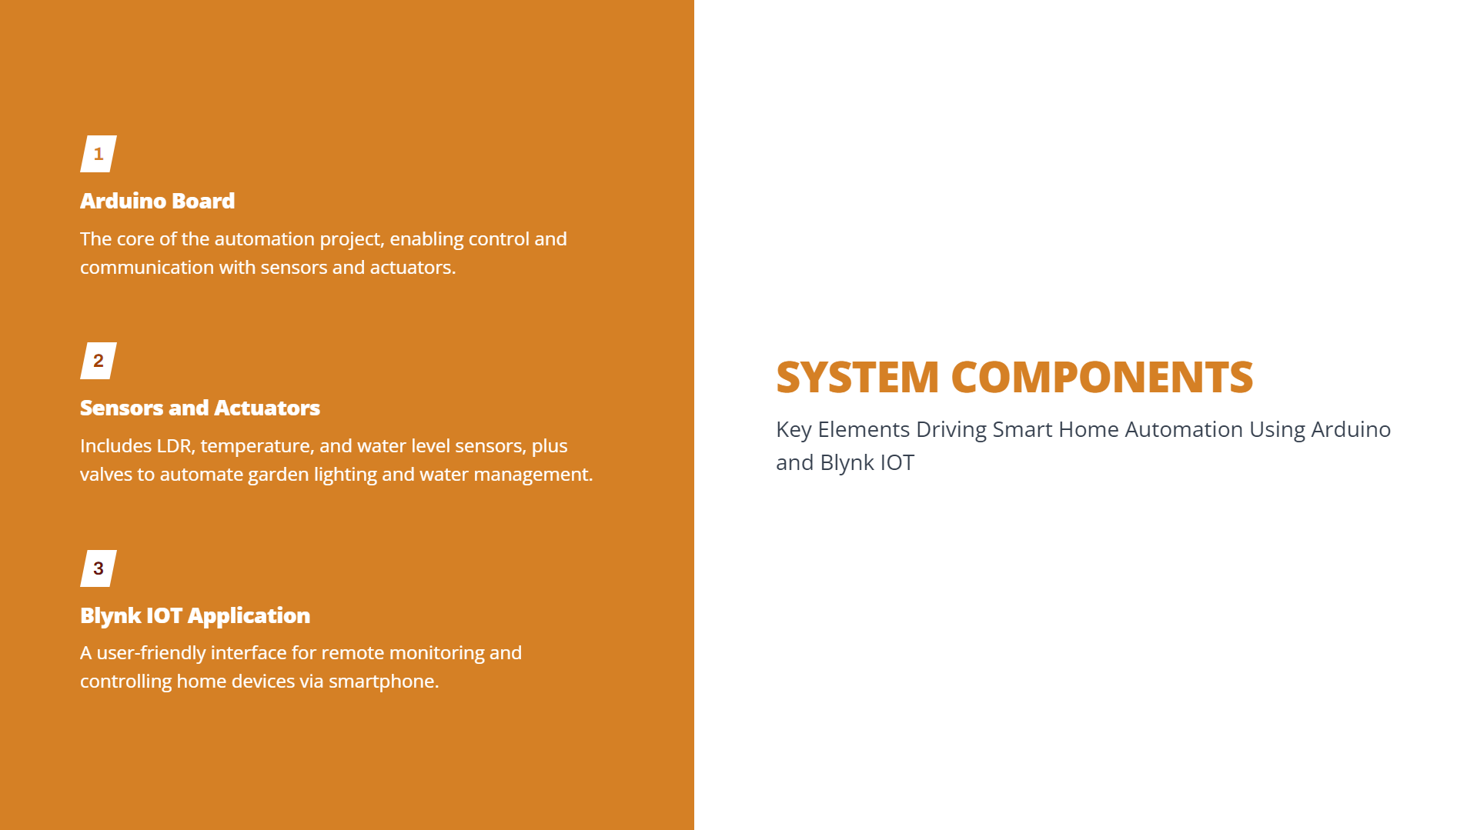
SYSTEM COMPONENTS
Key Elements Driving Smart Home Automation Using Arduino
and Blynk IOT

Slide 5
OVERVIEW OF HOME AUTOMATION
..iilllll SMART HO ME ADVANTAG ES
Exploringthe Advantages of Home Automation for Enhanced Living Experiences

Slide 6
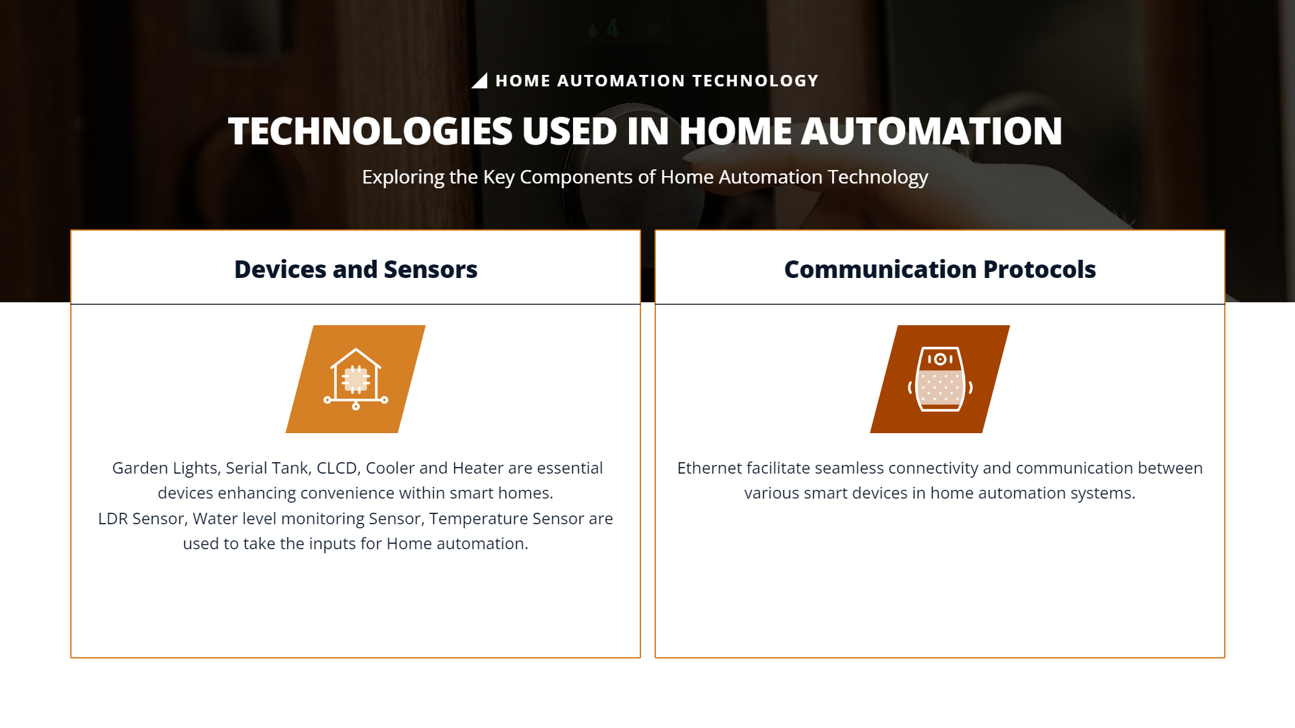


Devices and Sensors
Communication Protocols
(
)
Ethernet facilitate seamless connectivity and communication between various smart devices in home automation systems.
Garden Lights, Serial Tank, CLCD, Cooler and Heater are essential devices enhancing convenience within smart homes.
LDR Sensor, Water level monitoring Sensor, Temperature Sensor are used to take the inputs for Home automation.

Slide 7


Slide 8
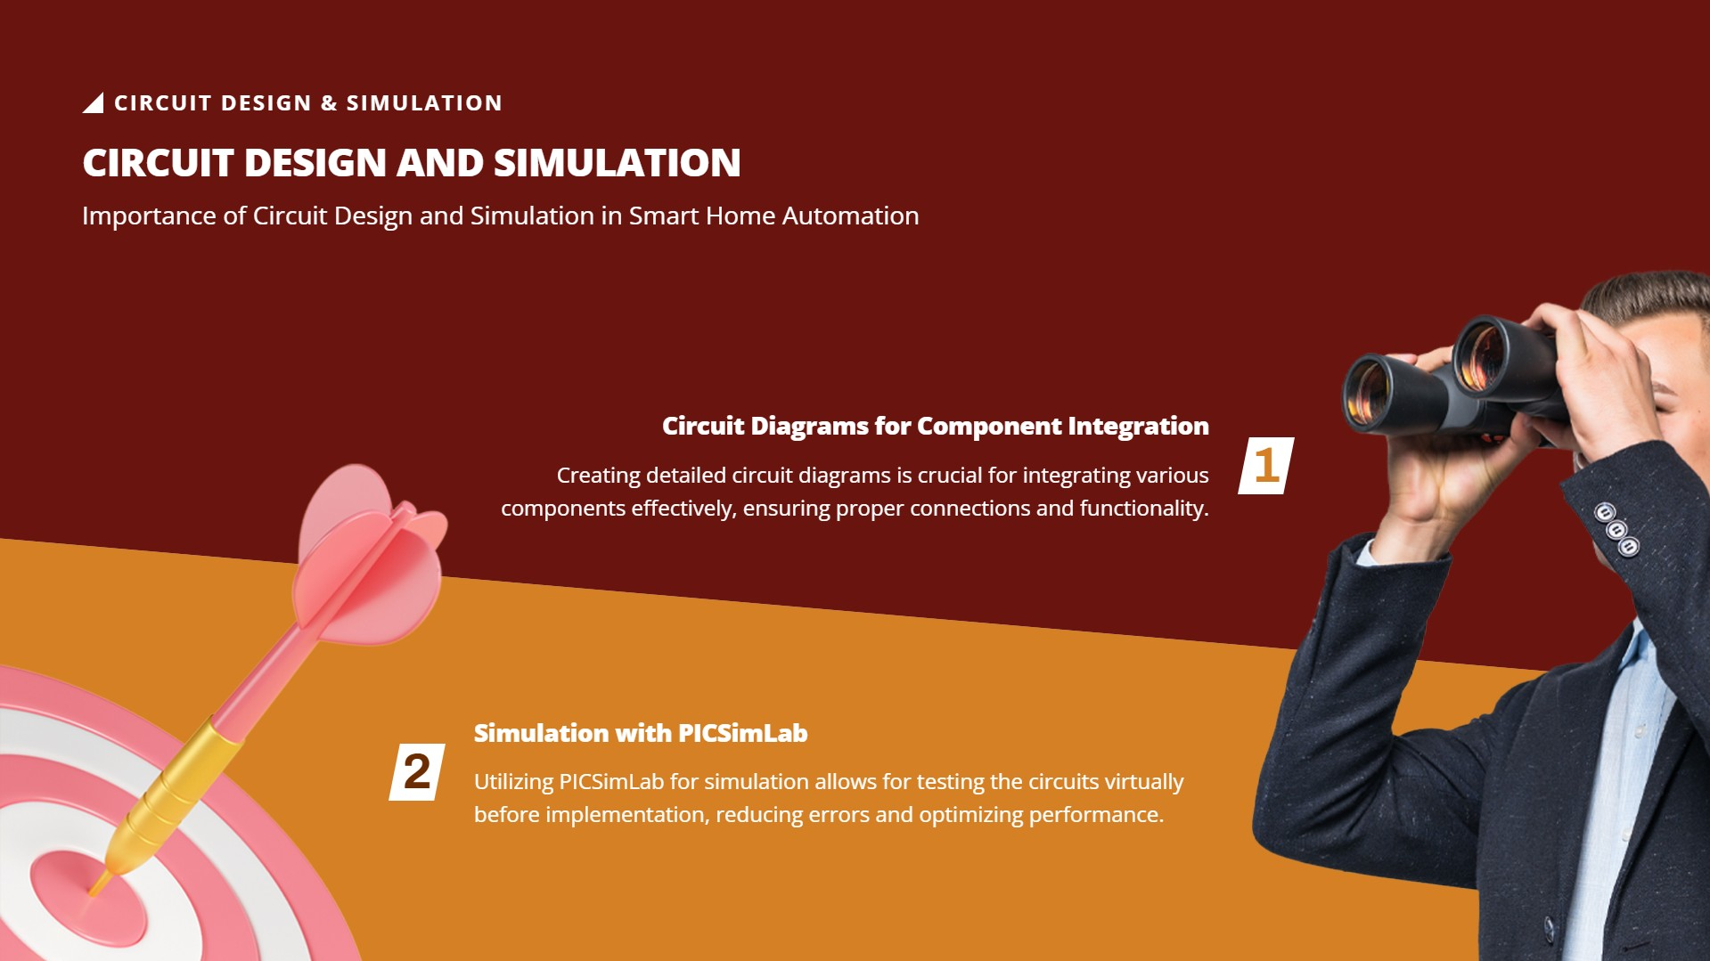

Slide 9
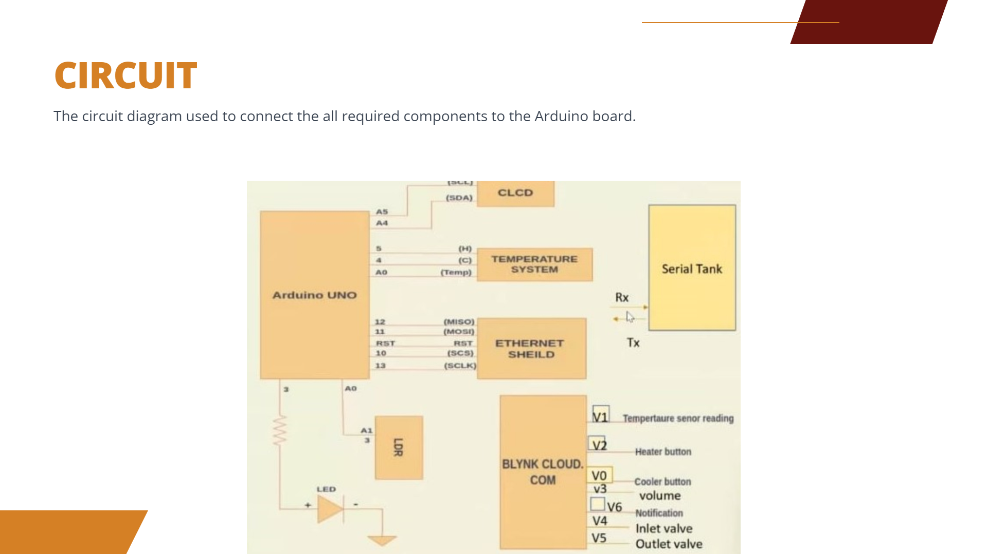

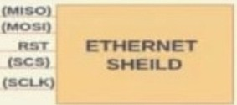


CIRCUIT
The circuit diagram used to connect the all required components to the Arduino board.
- - -
(.DA)
CLCD
Serial Tank
•
(H)
(C)
(1'1Hnp)
------
TEMPERATURE
SYSTEM
•
AO
Arduino UNO
Rx
• !.,. • Tx
ll
u
5T
JO
13
AO
vi
\l2
Trauresenor realfinG
Al
3
i
BlYNK CLOUD. COM
Heater button
VO
v3
V6 V4
vs
Coo '' button
volume
Nollheallon
Inlet valve Outlet valve
U::D
...

Slide 10


Slide 11
GARDEN LIGHT CONTROL
..iilllll GARDEN LIGHT AUTOMATION INSIG HT S
Understanding the Working of LOR Sensor for Garden Light Automation
Day and Night Detection
The LDR sensor detects ambient light levels to determine day and night, triggering the garden light control
system accordingly.
LDR Sensor Functionality
The LDR sensor works by changing its resistance based on the intensity of light, allowing it to sense variations in light levels.
Code Snippet Implementation
Utilizing CIC++ programming,the code snippet integrates the LDR sensor data to control the garden lights effectively.
Automation Benefits
Automating garden lights not only enhances convenience but also promotes energy efficiency by reducing unnecessary usage during daylight.

Slide 12
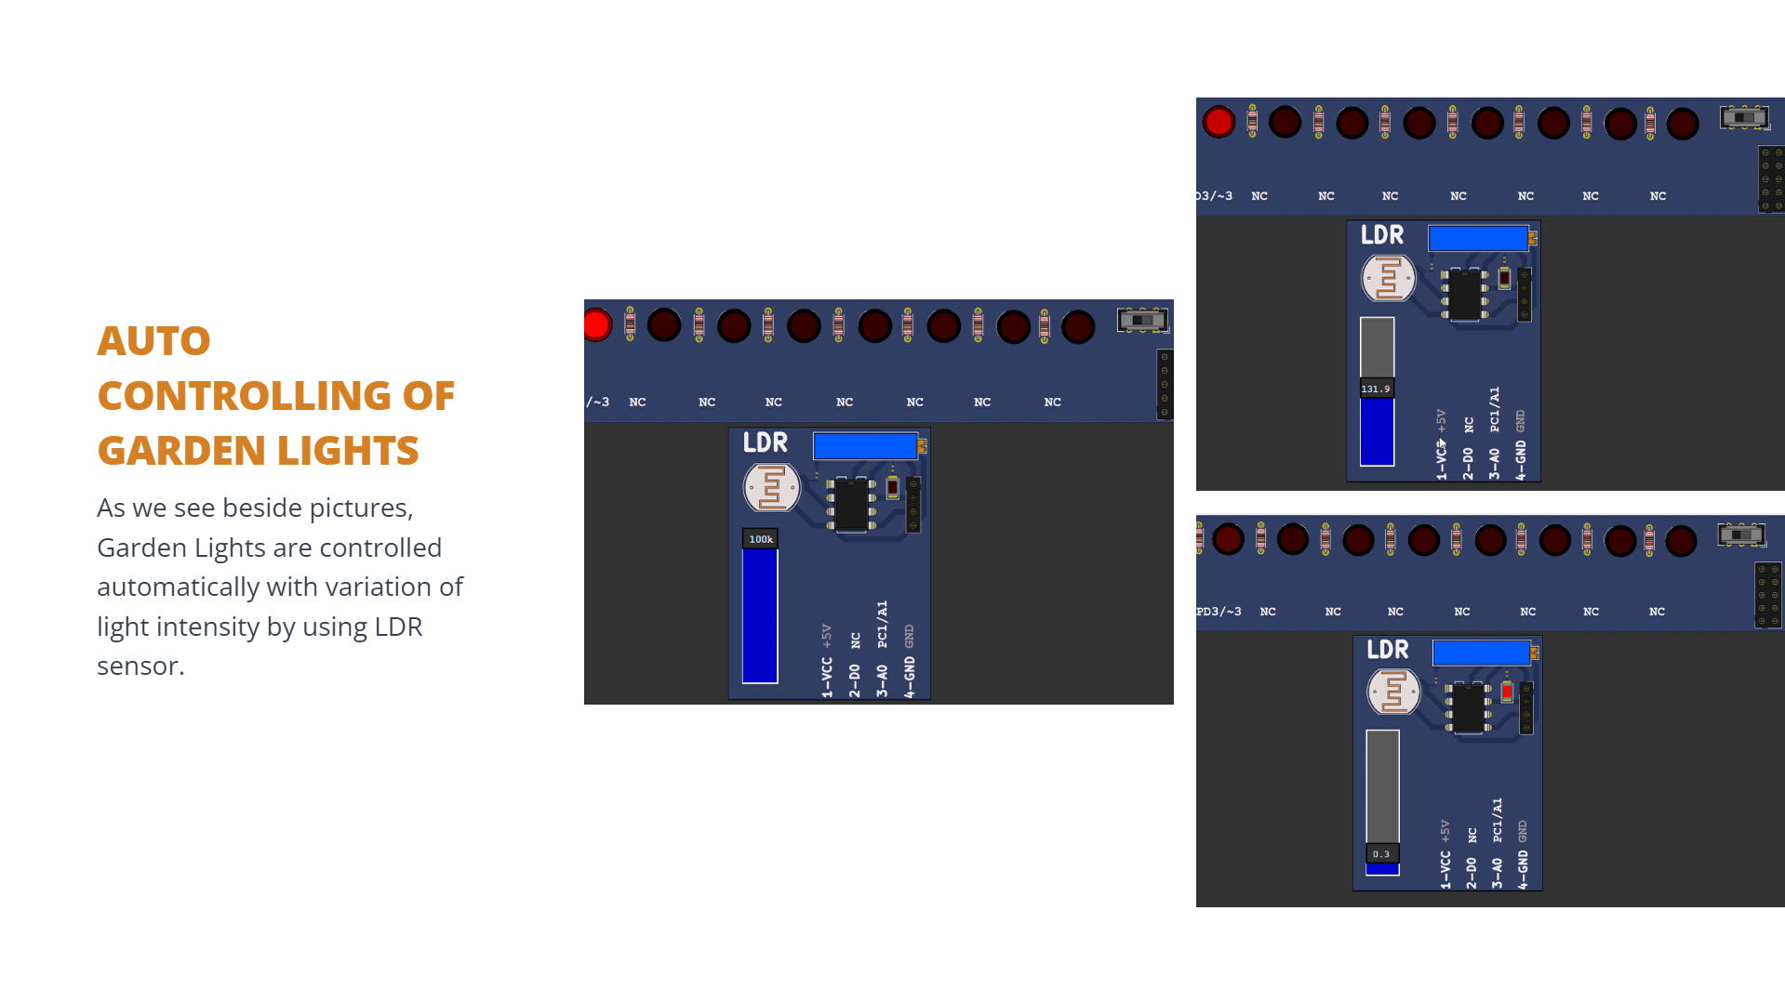
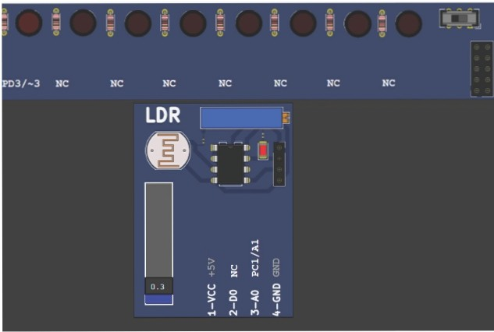
-
c
-
3/-3
NC
NC
NC
NC
NC
NC
NC
LOR
0
"11
•II
•II
• -
1;
A
n
AUTO
"
a
v
v
I
"
"
lll. ')
::c
lJ
....
u
.....
·
u
..
GARDEN LIGHTS
As we see beside pictures, Garden Lights are controlled automatically with variation of light intensity by using LDR sensor.
LOR
z
.... 0
Q
0
l JU k
>
I
0
z
I
"'^{I}
I
II·
""
II· -
II•
II·
:il
....
u
.....
z ..
...
u
u
Q
u
0
z
>
I
0
.... "
Q
<
I
I
I
"'

Slide 13
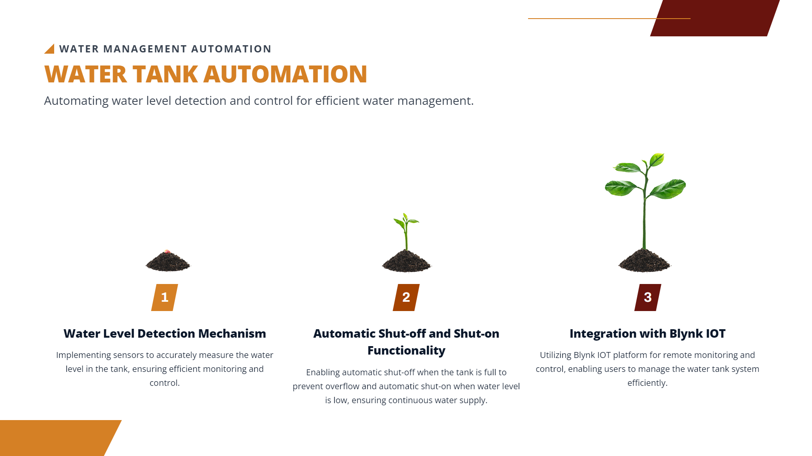


WATER TANK AUTOMATION
Automating water level detection and control for efficient water management.
..iilllll WATER MANAG E MENT AUTOMATION
i
Automatic Shut-off and Shut-on Functionality
Enablingautomatic shut-off when the tank is full to prevent overflow and automatic shut-on when water level is low, ensuring continuous water supply.
•
Water Level Detection Mechanism
Implementing sensors to accurately measure the water level in the tank, ensuring efficient monitoring and control.
Integration with Blynk IOT
Utilizing Blynk IOT platform for remote monitoring and control,enabling users to manage the water tank system efficiently.

Slide 14
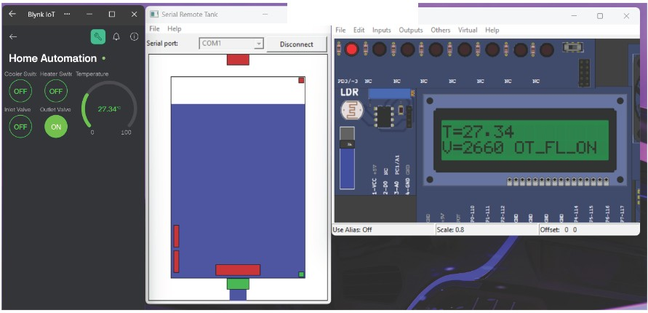
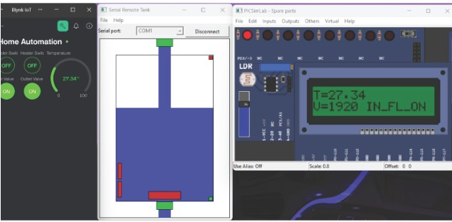
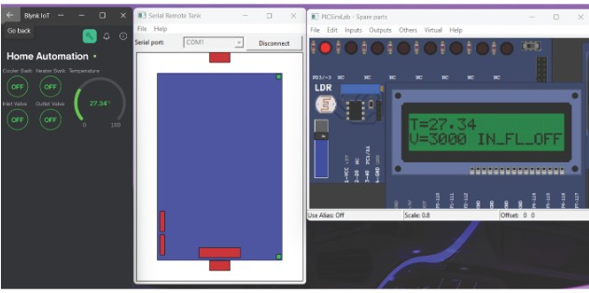
::1
)(
j] PICSimlab Spare parts
CONTROLLI NG WATER TANK
By using Blynk IOT APP we can control! inlet and oulet of a water tank.
The shown images:
Enabled outflow of a tank by using Blynk IOT APP.
When water tank level
reaches at a threshold then inflow is enabled automatically.
When the water tank is filled then the inflow is automatically turned off.

Slide 15
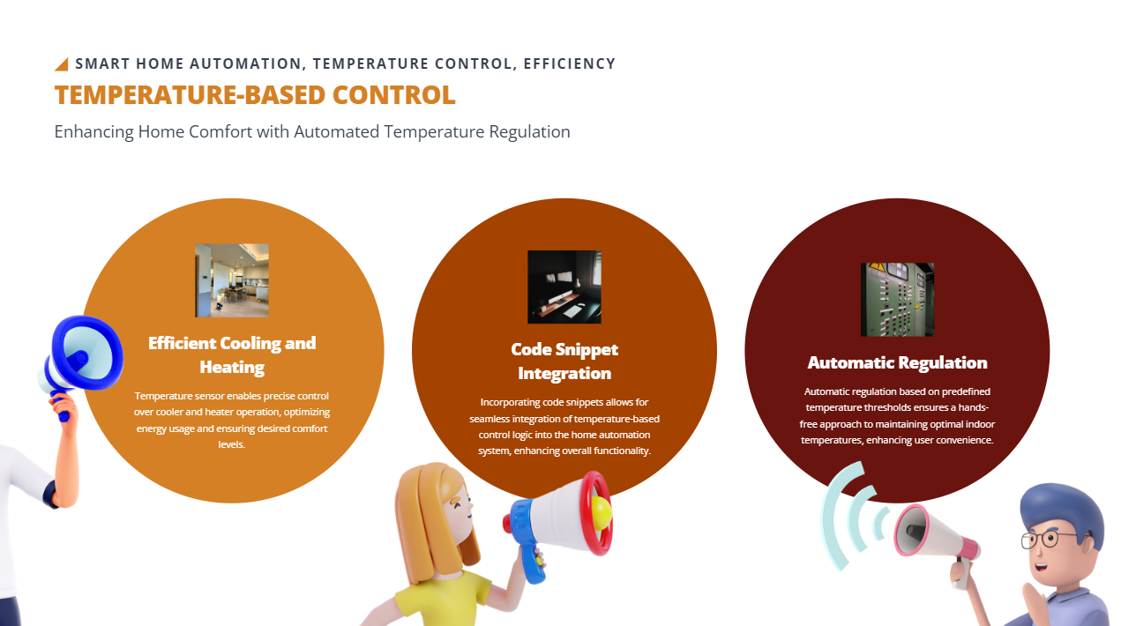
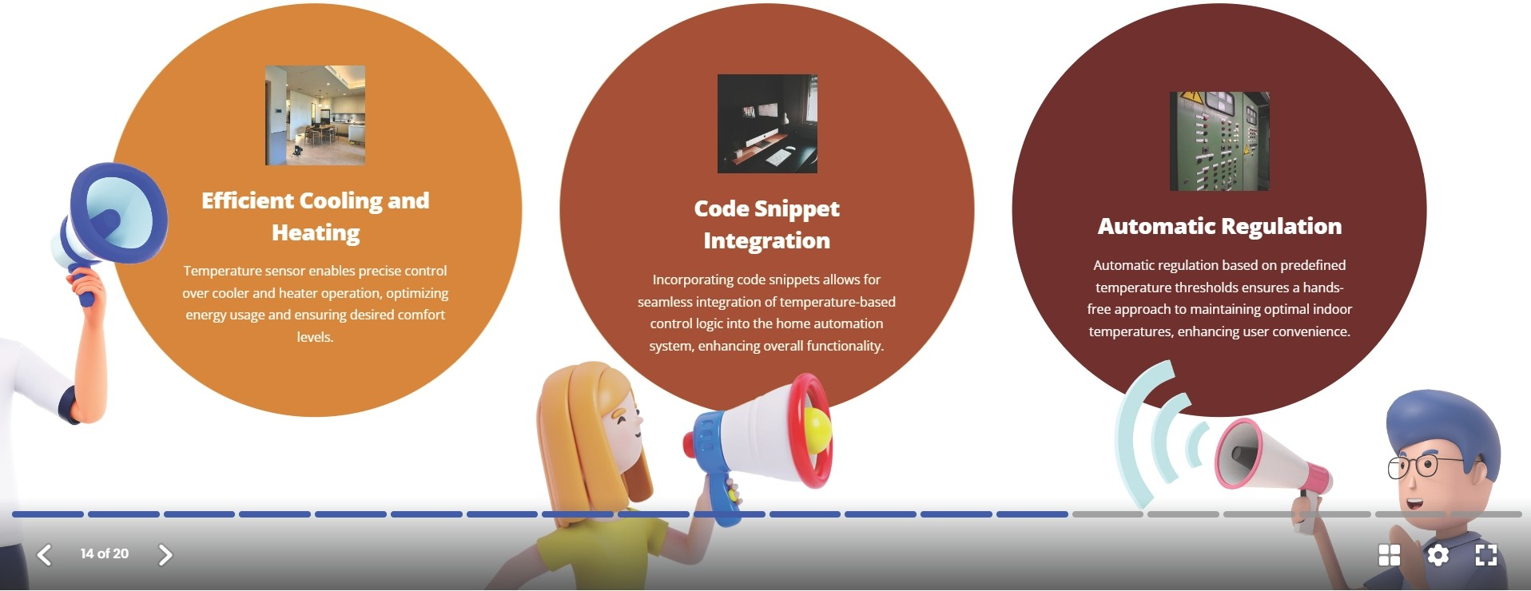
..iilllll SMART HOME AUTOMATION, TEMPERATURE CONT RO L, EFFICIE NCY
TEMPERATURE-BASED CONTROL
Enhancing Home Comfort with Automated Temperature Regulation

Slide 16
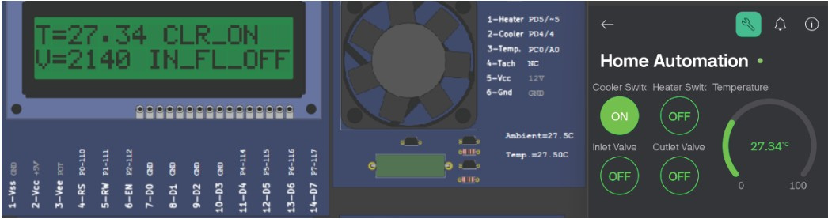
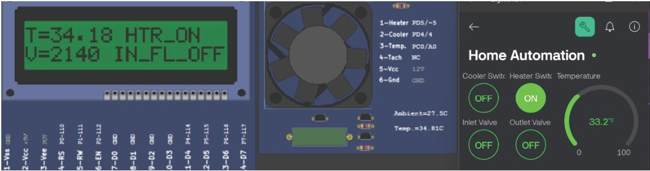
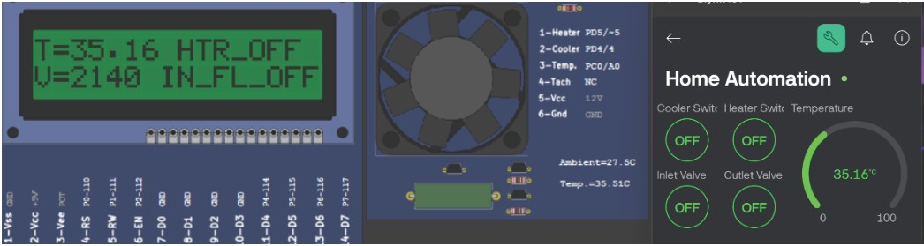
CONTROLLI NG HEATER Ir COOLER
By using Blynk IOT APP we control heater and cooler. The shown beside images:
Cooler is turned on by using Blynk IOT APP.
Heater is turned on by using Blynk IOT APP.
When the temperature is above threshold then the heater will automatically turned off.

Slide 17
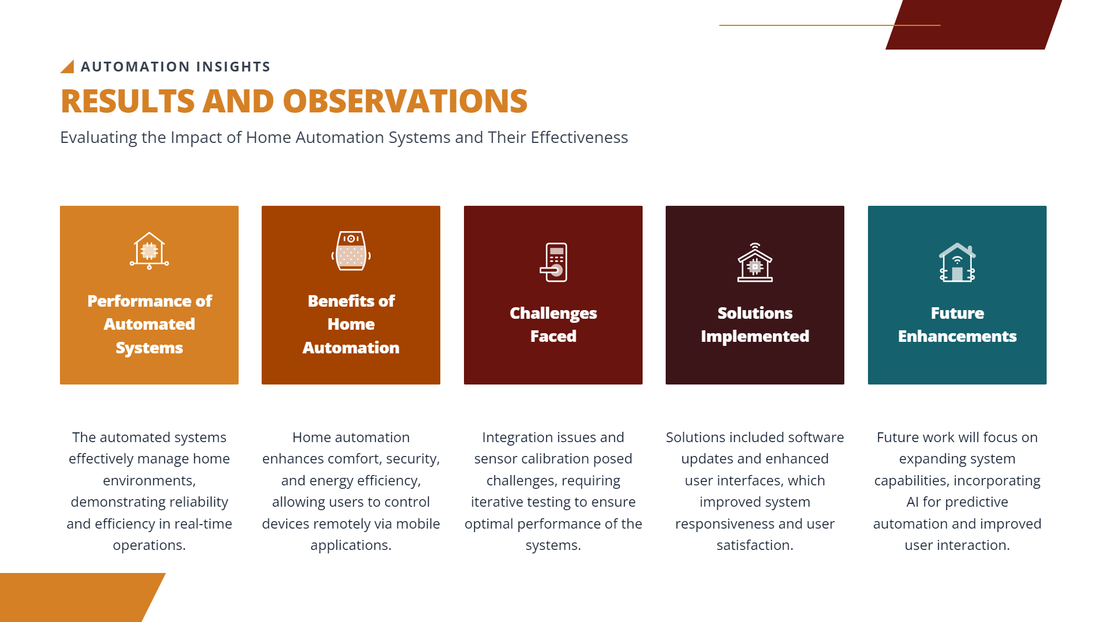
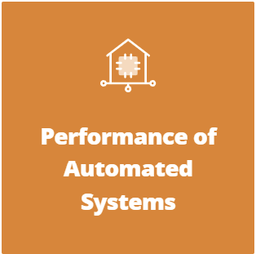
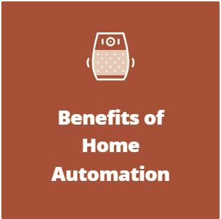


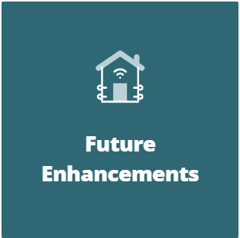
RESULTS AND OBSERVATIONS
..iilllll AUTOMATION INSIGHTS
Evaluating the Impact of Home Automation Systems and Their Effectiveness
The automated systems effectively manage home | Home automation enhances comfort, security, | Integration issues and sensor calibration posed | Solutions included software updates and enhanced | Future work will focus on expanding system
environments, demonstrating reliability | and energy efficiency, allowing users to control | challenges, requiring iterative testing to ensure | user interfaces,which improved system | capabilities, incorporating Al for predictive
and effic iency in real-time operations. | devices remotely via mobile applications. | optimal performance of the systems. | responsiveness and user satisfaction. | automation and improved user interaction.

Slide 18
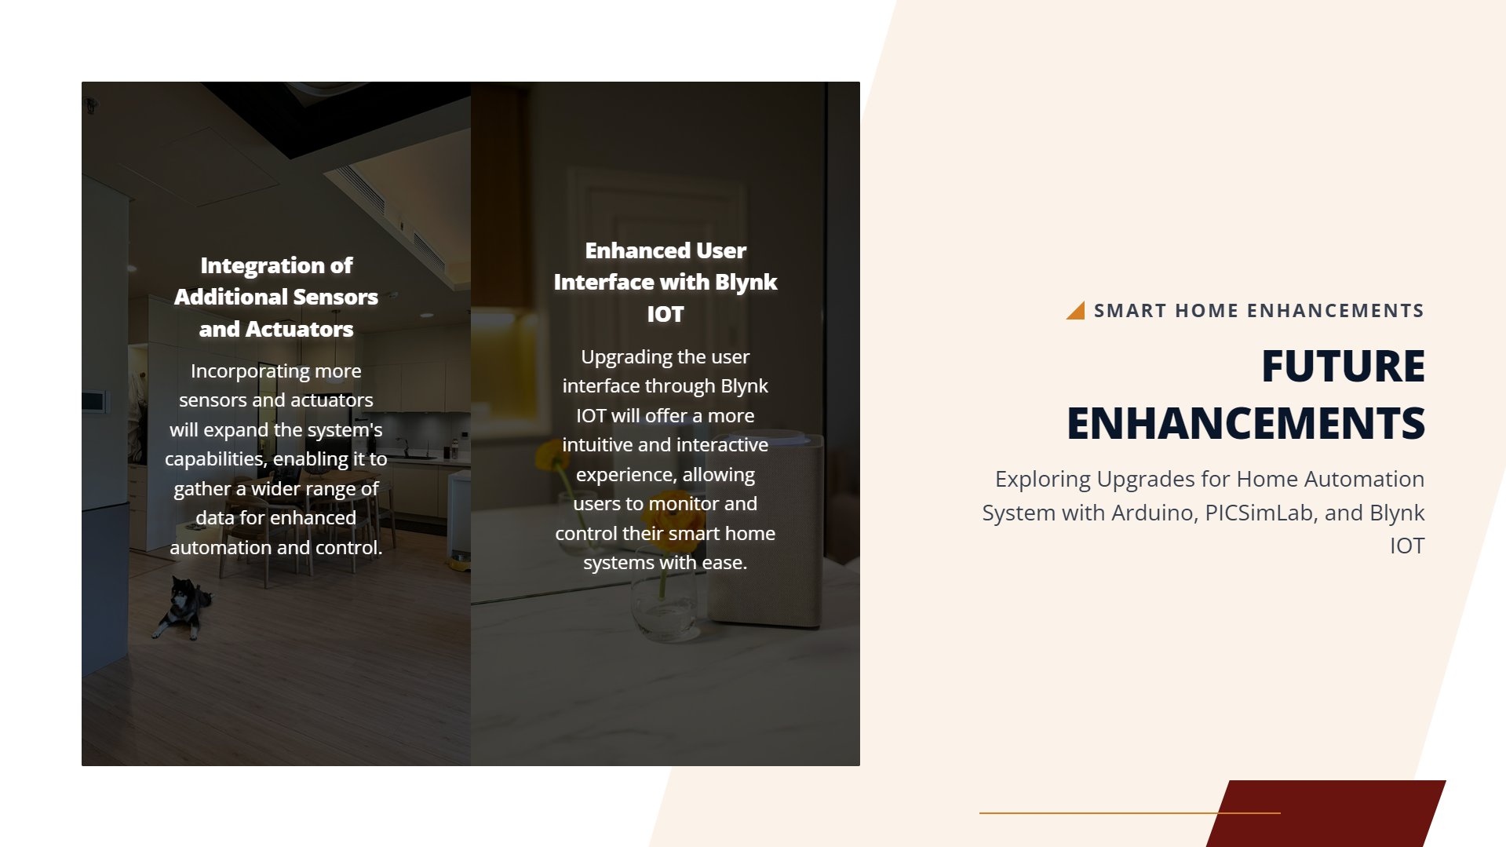
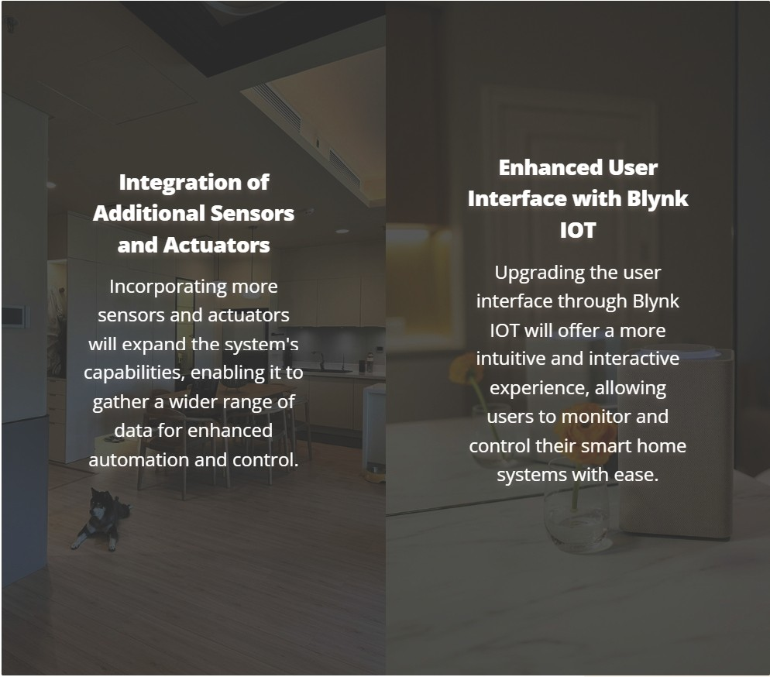

.... SM A RT H O M E E N HA N C E M E N TS
FUTURE
ENHANCEM ENTS
Exploring Upgrades for Home Automation System with Arduino, PICSimlab, and Blynk
IOT

Slide 19
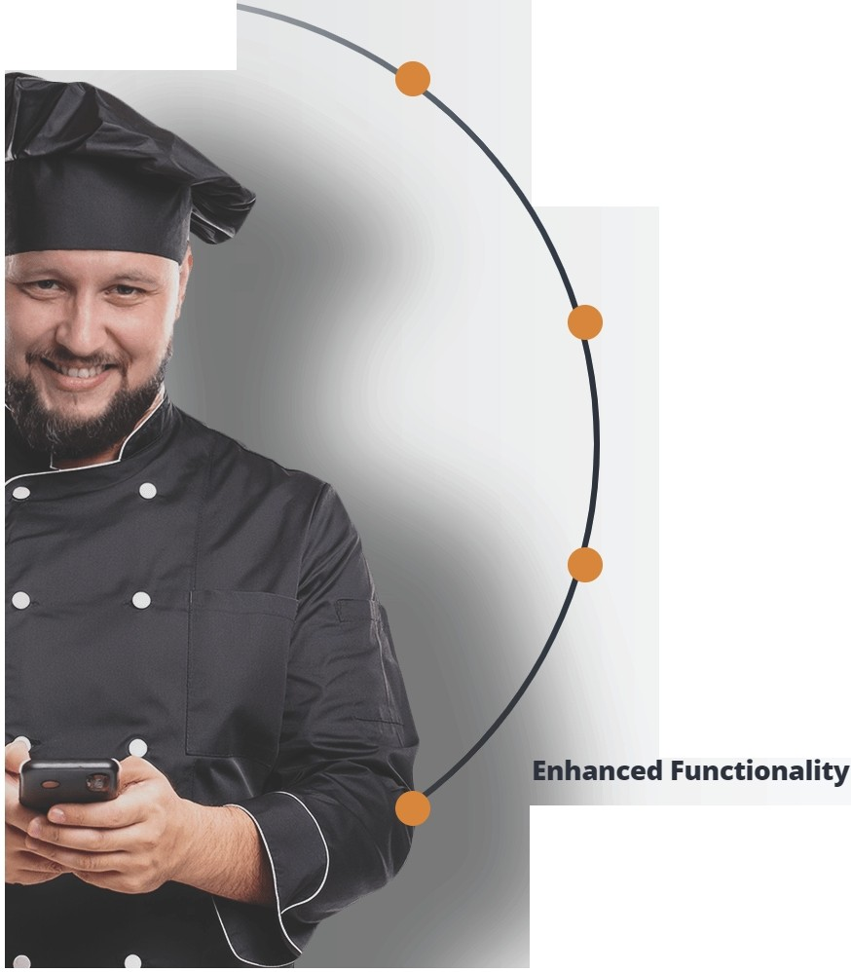
..iilllll P ROJ ECT SU M M A RY & F U TU R E ...
Comprehensive Summary
Recap of the project objectives, implementation details, and achieved results.
CONCLUSION
Reflecting on the project outcomes and future possibilities in smart
home automation
Key Takeaways and Learnings
Insights gained from working on the smart home automation project, including technical skills and problem-solving abilities.
Future Scope
Exploring potential improvements and advancements in smart home automation technology, such as incorporating Al or enhancing user interface.
Opportunities to expand system capabilities, like integrating voice command features or adding remote access options.

Slide 20


Slide 21


